Slide 1
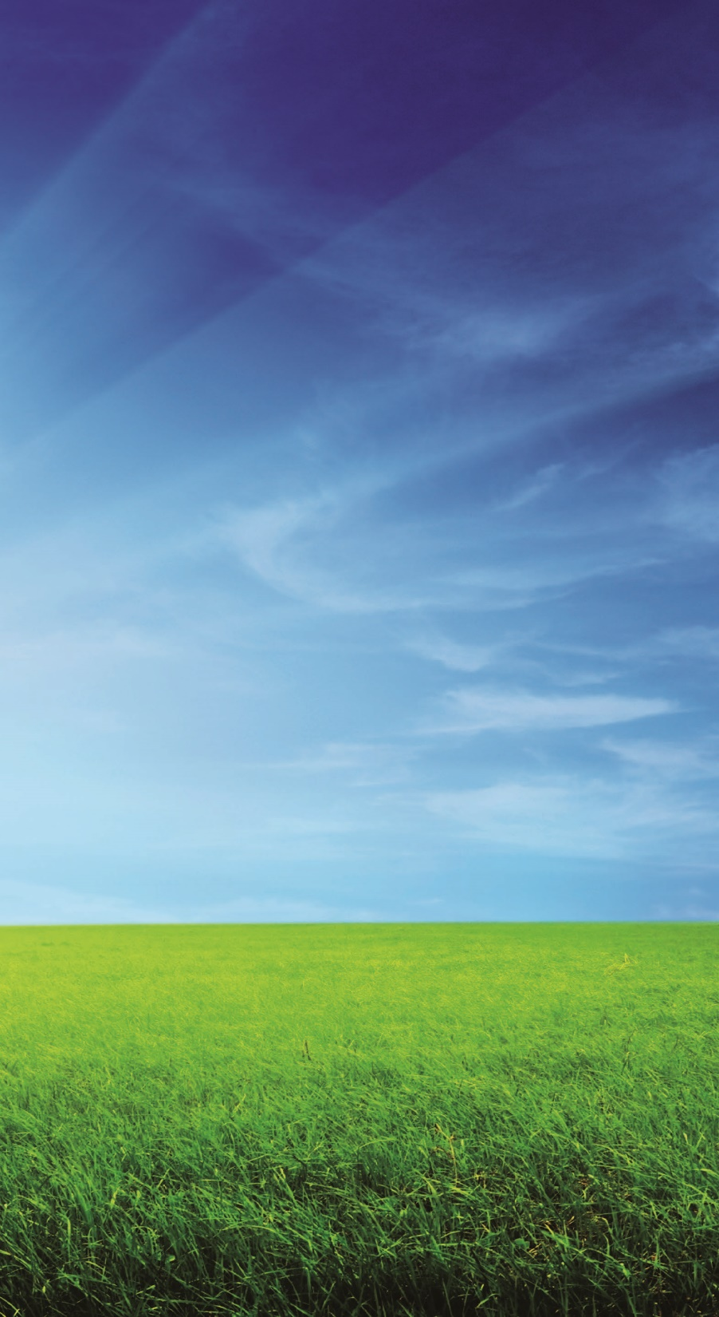
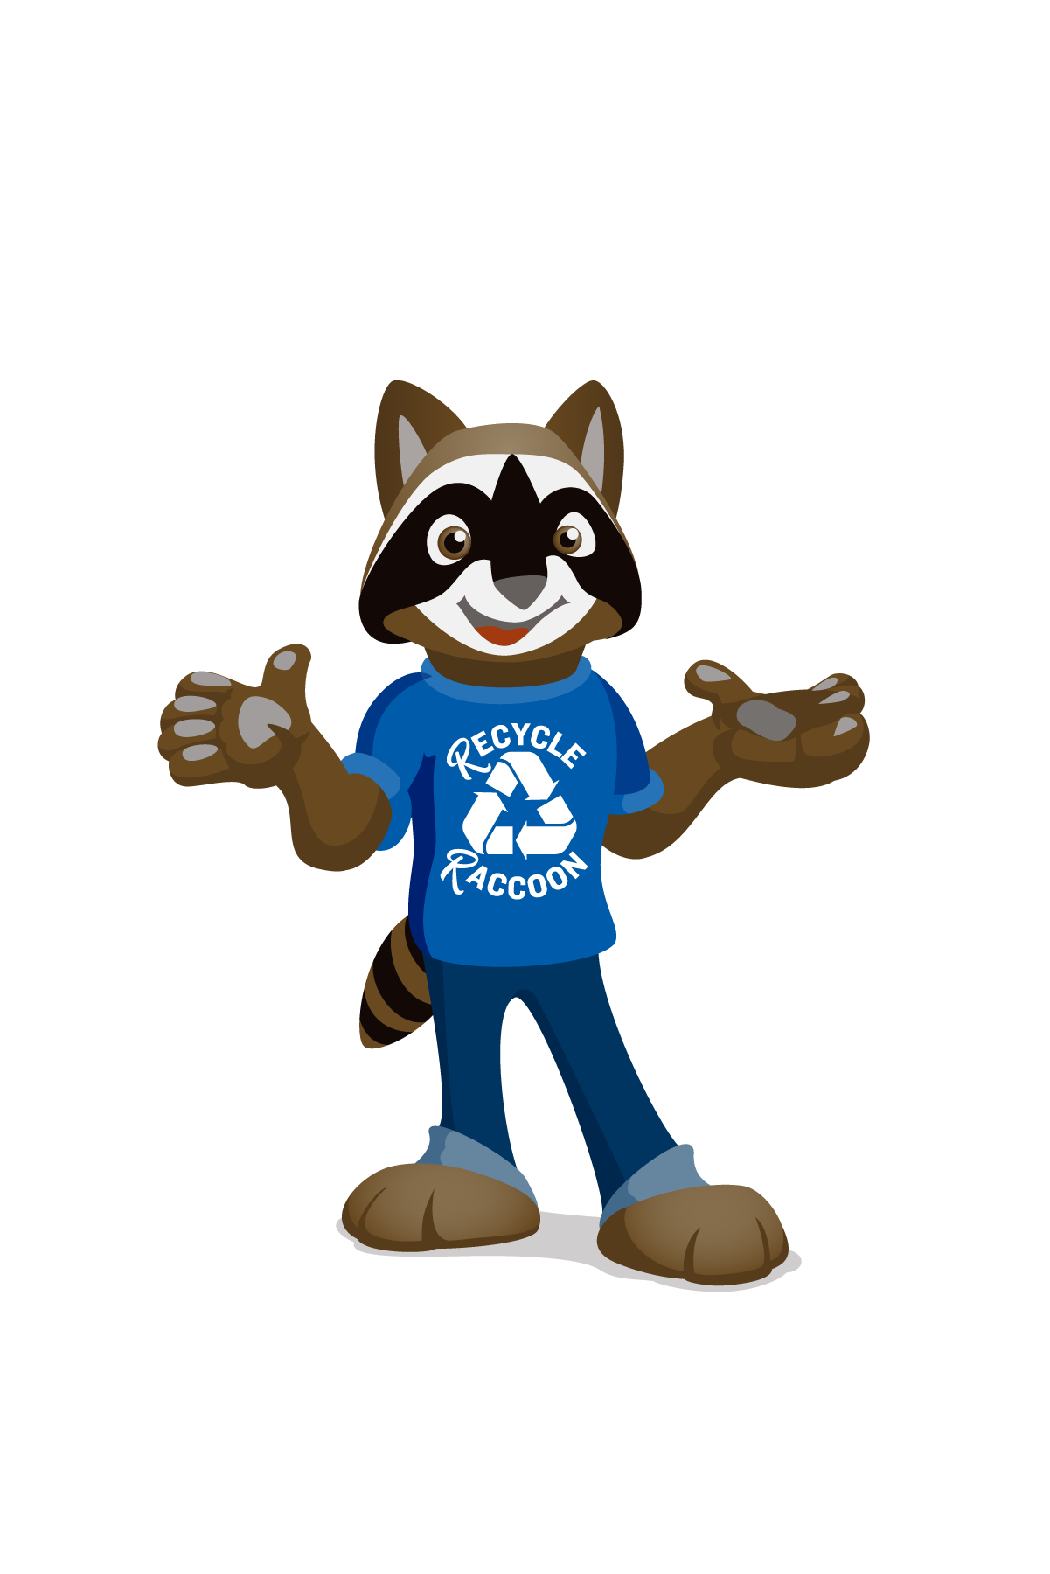
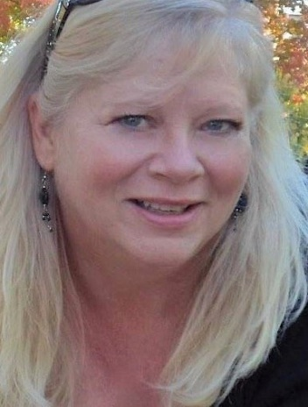
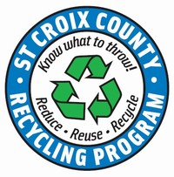
Your Actions Matter!
Notes:
Good morning, everyone! Thank you for having me visit your class today! My name is Kris and I work for St. Croix County as their Recycling Specialist.
This morning I am here to teach you about what recycling is, how it can help the earth and how Your Actions Matter. Recycle Racoon is going to help guide us on our journey.

Slide 2

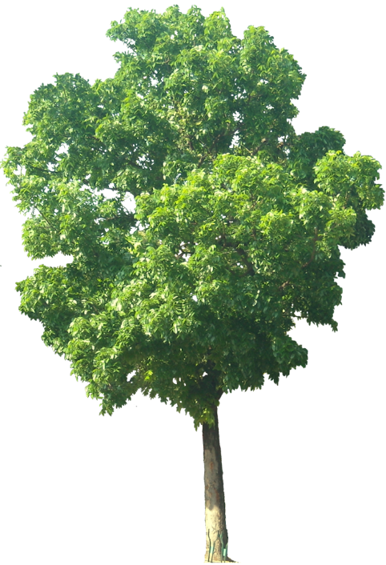
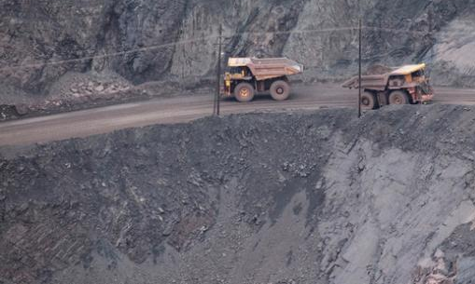
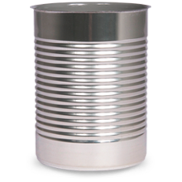
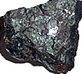
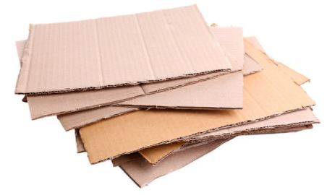
Recycling is saving and re-using our Natural Resources So, what are Natural Resources?
These are supplies we get from the earth and use to make the things we need!
Notes:
Recycling is saving and re-using our Natural Resources So, what are Natural Resources? Natural Resources are the supplies we get from the earth and use to make other things we need (kind of like art supplies).
Rocks are mined from the earth to make fuels and metals for cars, buildings and the containers we put our food / beverages in.
Trees are cut down and used to make cardboard, books, coloring paper, food boxes.
Water is for drinking; we use it to make food and water our plants to keep them healthy.
Just like art supplies, our Natural Resources can get used up and we might run out of them.

Slide 3
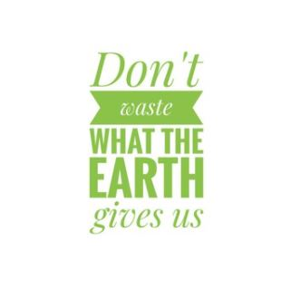
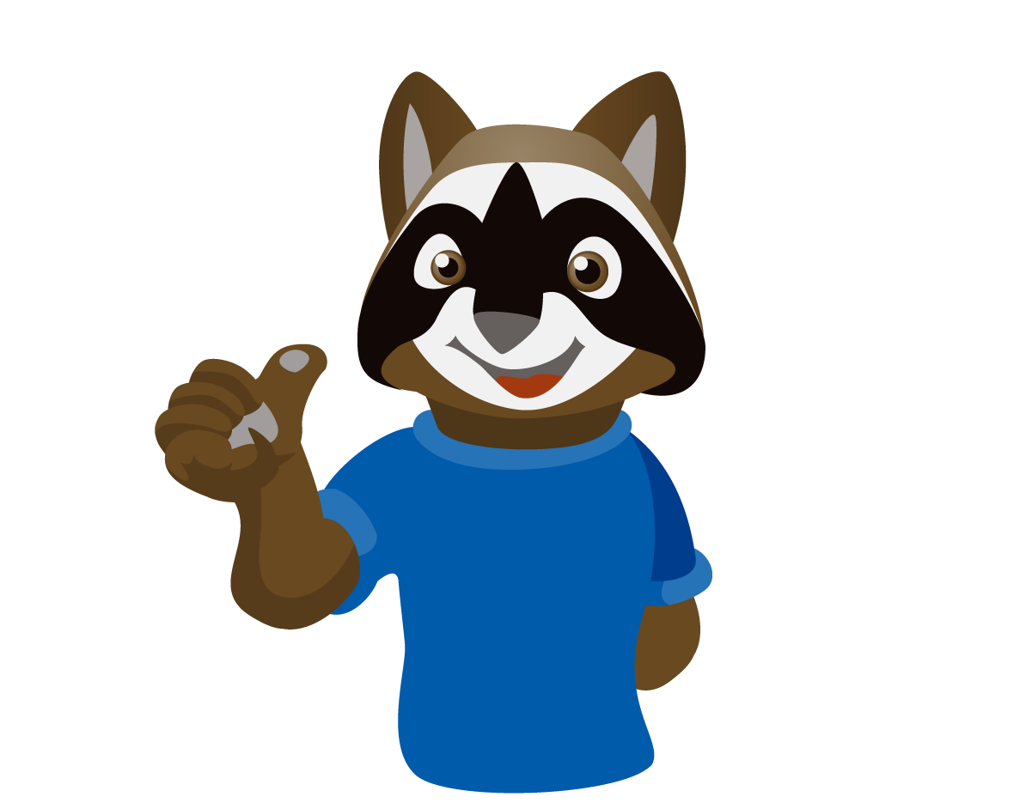
Think about the 3-Rs
Reduce!
Reuse!
Recycle!
Notes:
Since we don’t want to waste the natural resources that the earth gives us,
We should think about the 3-Rs
Reduce | Reuse | Recycle

Slide 4
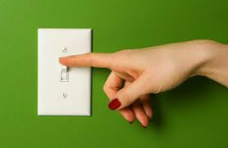
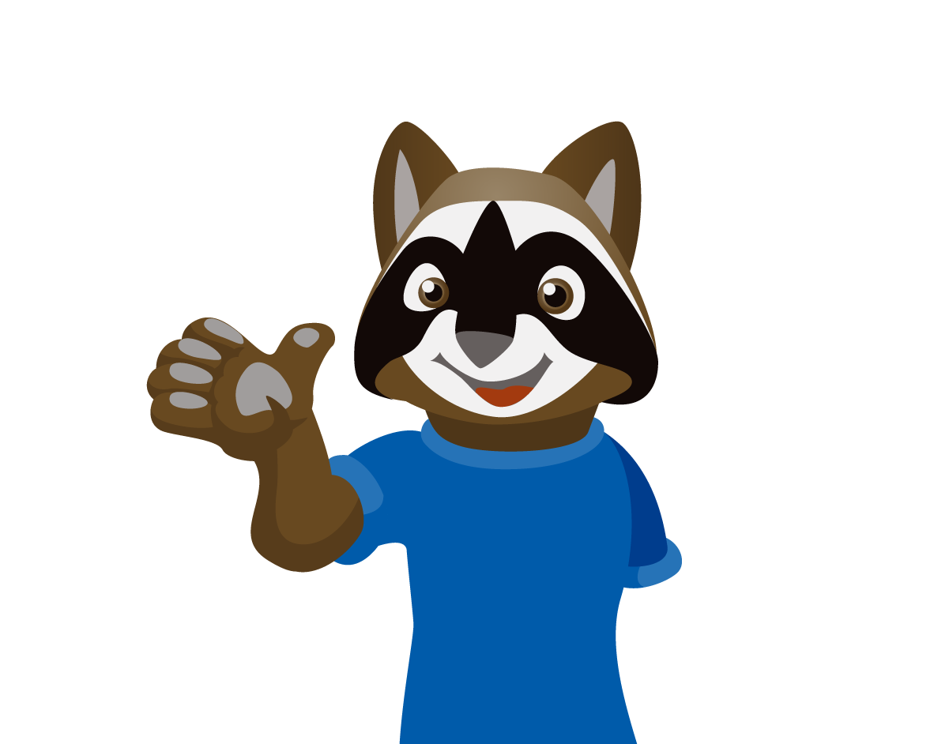
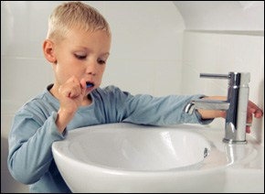
REDUCE
This is first and MOST important!
Reduce means to “Use Less”
Notes:
The FIRST thing we should always try is to REDUCE!
This means to “Use Less” of something so that we don’t waste it.
This boy shuts off the water while he brushes his teeth. When he is ready to rinse his mouth, he will turn it back on. Then he doesn’t waste water!
Does mom remind you to turn off the lights when leaving a room? That is because she doesn’t want to waste electricity when it isn’t needed.
Walk or ride your bike when you can. This will reduce gas for the car and that will make your dad happy!

Slide 5
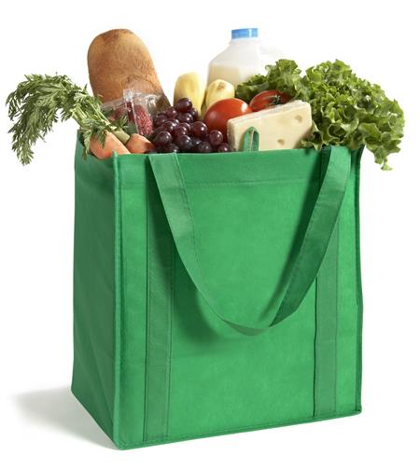
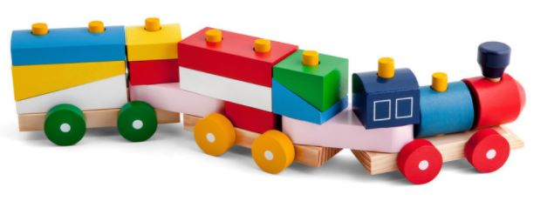
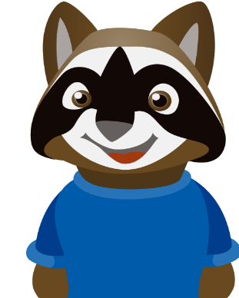
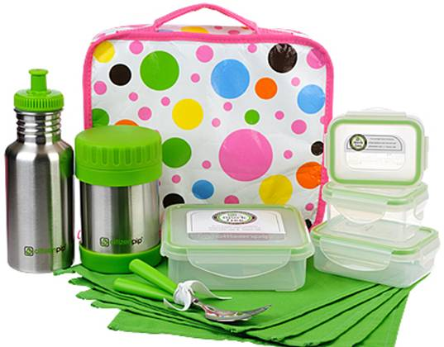
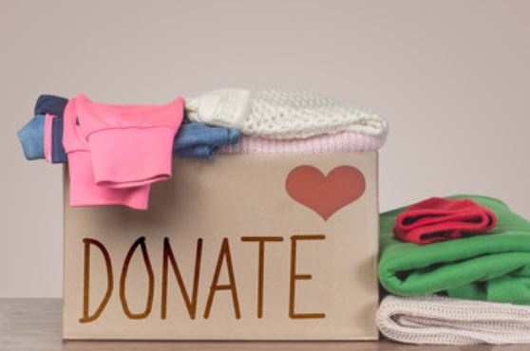
REUSE
REUSE means to “use again and again”
Notes:
REUSE means to “use again and again”. What are some things you can REUSE?
Maybe when you shop with your parents, they have reusable bags for your groceries .
When you bring your lunch to school do you use a lunch box that can be used over and over again? That is REUSE.
DONATING or SHARING your things with others is also a way to REUSE
What happens to your clothes when you get too big for them? Hopefully, you can give them to someone else to wear. Or you might have toys that you don’t play with anymore. Give them to a little brother, sister, cousin or neighbor.

Slide 6
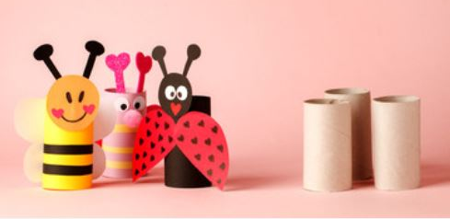
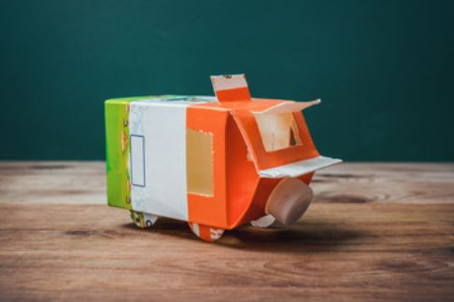
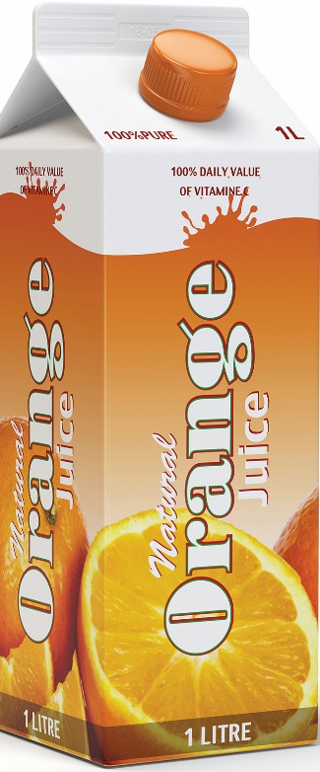
REUSE
Here are some fun ideas for reusing …
Notes:
REUSING can be fun for craft or art projects too

Slide 7

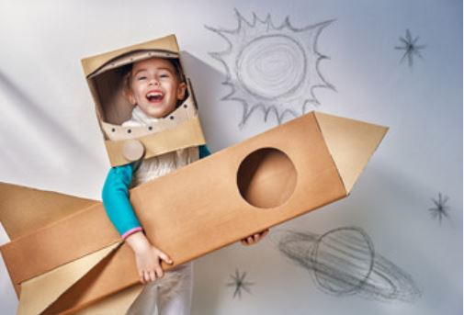
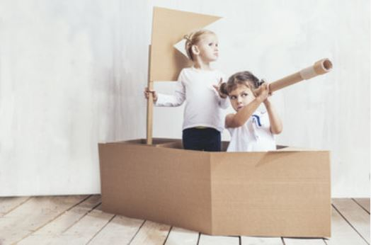
REUSE
Here are more fun ideas for reusing …

Slide 8
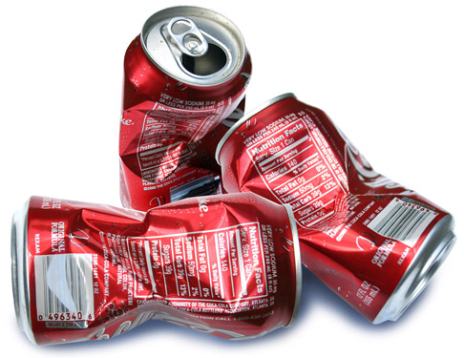
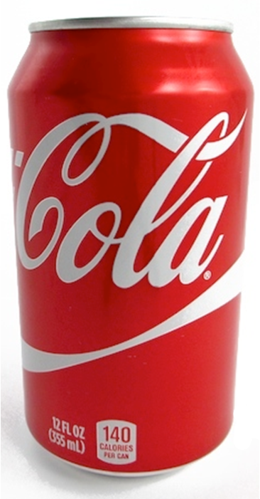
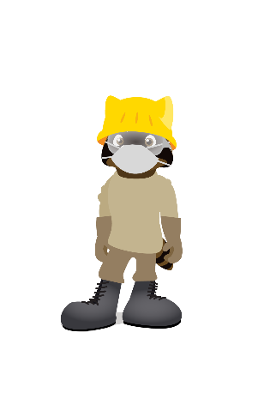
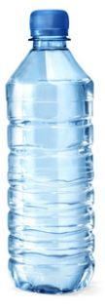
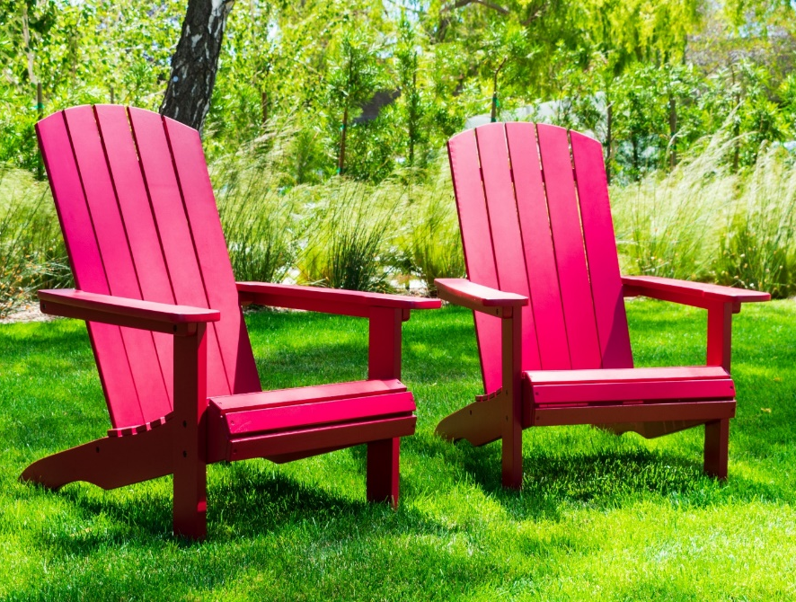
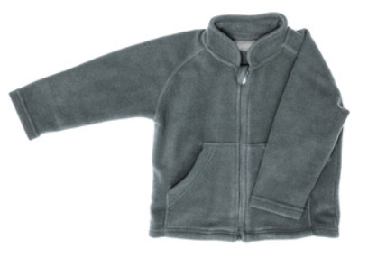
RECYCLE
Recycle means when something OLD or USED becomes something NEW!
Notes:
Recycle means when something OLD or USED becomes something NEW again!
When you choose to put your empty water bottles or soda cans into the recycling container, you are making YOUR ACTIONS MATTER.
You are saving the natural resources it takes to make new cans and bottles by using the resources of the old cans and bottles.
Now you are RECYCLING!

Slide 9
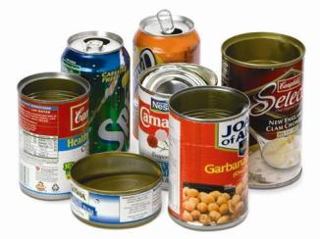
Recycle Aluminum, Steel and Tin
Are empty soda cans and food cans a natural resource?
THEY SURE ARE!
Notes:
So, what should we recycle?
Are empty soda cans and food cans a natural resource? THEY SURE ARE!
RECYCLE aluminum, steel and tin cans.
Some examples are soda cans, soup cans or even pet food cans

Slide 10
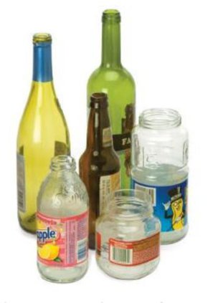
Glass Bottles and Food Jars can be Recycled
Glass is a very versatile resource and can be recycled to infinity and beyond!
Notes:
Glass Bottles and Food Jars can be Recycled
Glass is a very versatile resource and can be recycled to infinity and beyond!
Glass from fruit juice, pickles and spaghetti sauce are just a few examples of glass containers that can be recycled.

Slide 11
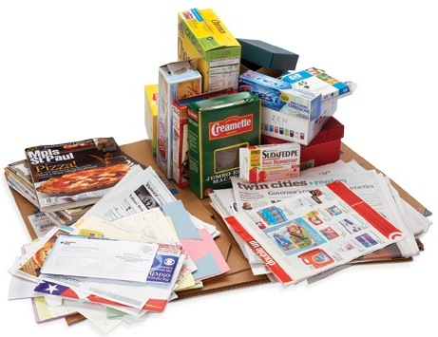
Recycling Paper and Cardboard Helps Save Trees
Notes:
Recycling Paper and Cardboard Helps Save Trees
All of these types of paper can be recycled at school and home. They can even be mixed in with the bottles and cans
Make sure you squish them flat before you put them in the recycling bin.

Slide 12
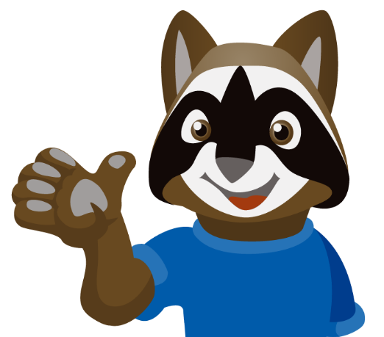
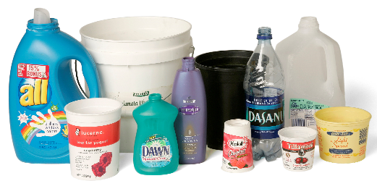
Plastic Bottles, Tubs and Food Jars can be Recycled
These plastics are the kind used for beverages, food, cleaning and personal care
Notes:
Plastic Bottles, Tubs and Food Jars can be Recycled
These plastics are the kind used for beverages, food, cleaning and personal care. Put the caps back on.
You can recycle: water and soda bottles | yogurt, sour cream, cottage cheese containers | shampoo, dish soap, laundry bottles just to name a few

Slide 13
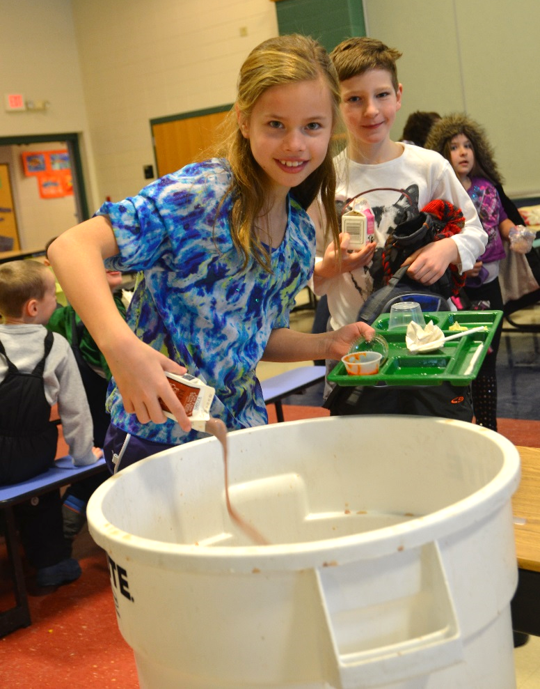
Recycling Tips
If there is stuck on food and sticky liquids in your recyclables, it will make everything else dirty.
That is called CONTAMINATION!
Keep food and liquids out of the recycling bin
Notes:
Recycle Raccoon has some tips for you to do at home and school.
Keep food and liquids out of the recycling bin. If there is stuck on food and sticky liquids in your recyclables, it will make everything else dirty. That is called CONTAMINATION!
This girl is emptying her leftover milk into a designated emptying bin in the school lunchroom. Then she is going to place that empty milk carton into the recycling bin.

Slide 14
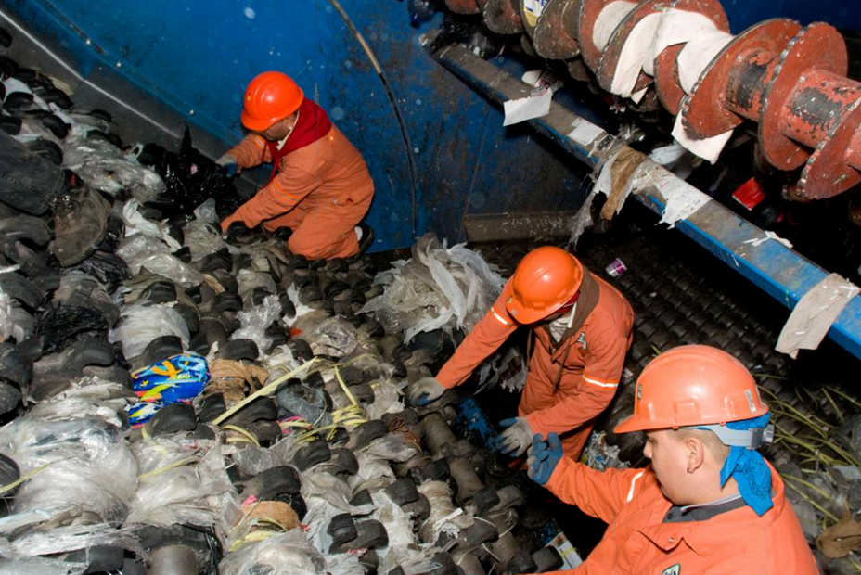
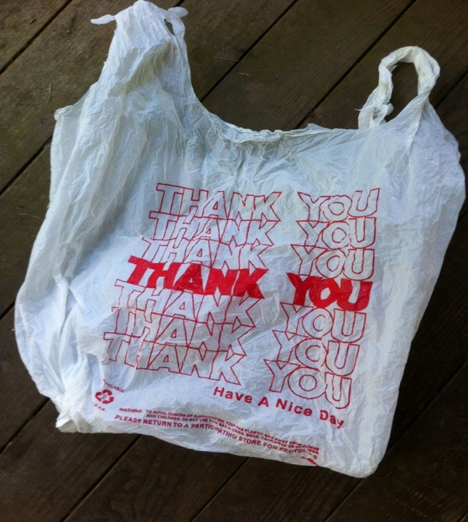

Recycling Tips
Plastic bags cause BIG problems!
Keep plastic bags OUT of the recycling bin
Notes:
Plastic bags cause BIG problems! Recycling Tip: Keep them OUT of your recycling bin
These workers must climb into sorting machines and cut out lots and lots of bags that jam up the recycling equipment. It is very dangerous for them, and it wastes a lot of time.

Slide 15
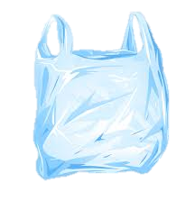
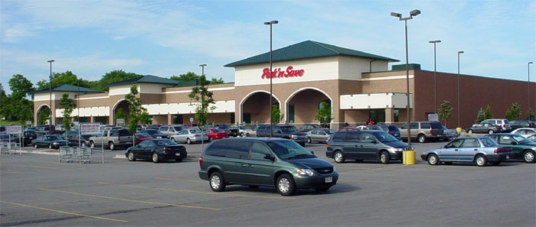
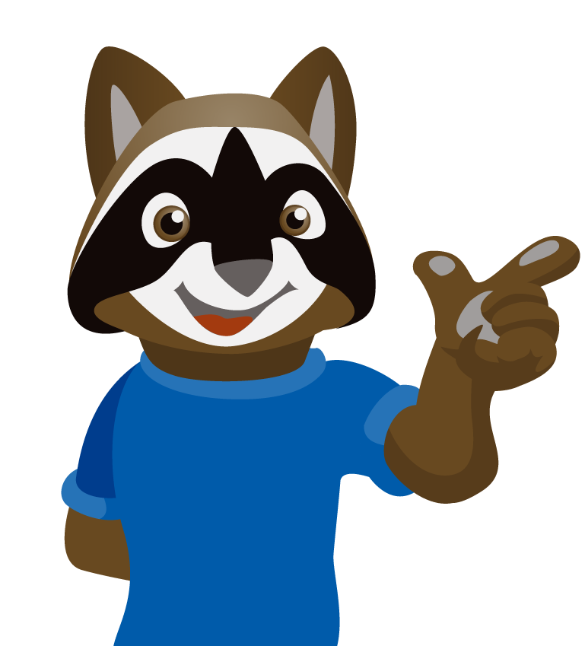
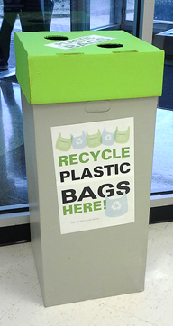
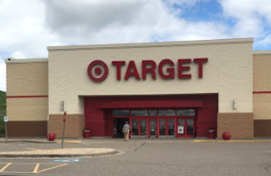
Recycle plastic bags by bringing them back to Target, Walmart or the Grocery Store
Notes:
But this is what you CAN do with those plastic bags…
Under my kitchen sink I have one plastic bag that I stuff all my other plastic bags into. When it is full, I bring the plastic bags back to Target, Walmart or the Grocery Store.
Ask your mom or dad if you can do this.
It is just another way you can recycle and make Your Actions Matter!

Slide 16
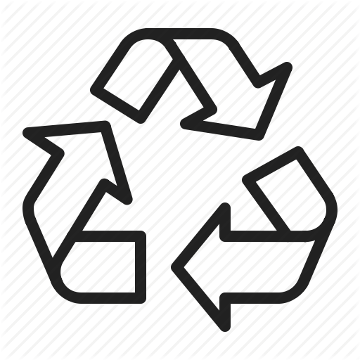
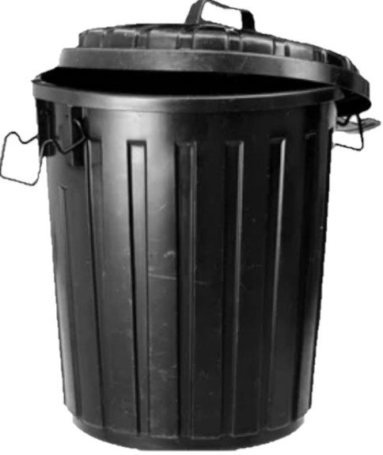
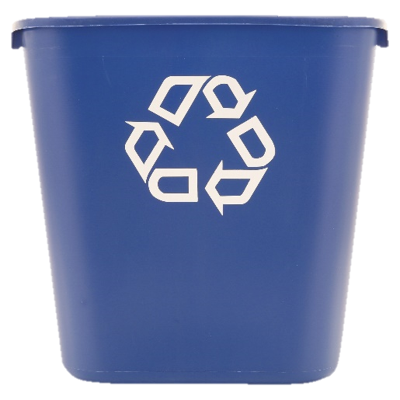
Once you have sorted your RECYCLING from your TRASH, where does it all go?
Recycle
Trash
Notes:
Do you see the 3-arrow symbol on the blue container? That symbol means recycling.
You will find it on bottles, cans and other food containers. It means you should put it in RECYCLING

Slide 17
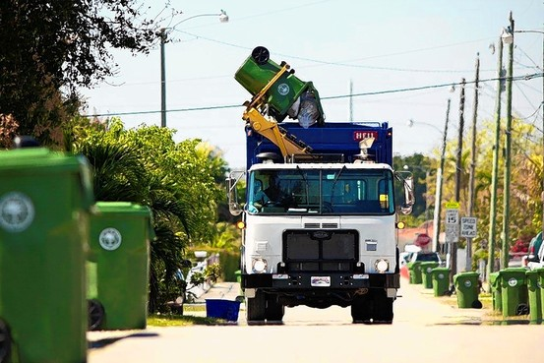
TRASH Collection
Trash
Notes:
When the trash/garbage is collected, where does it go?

Slide 18
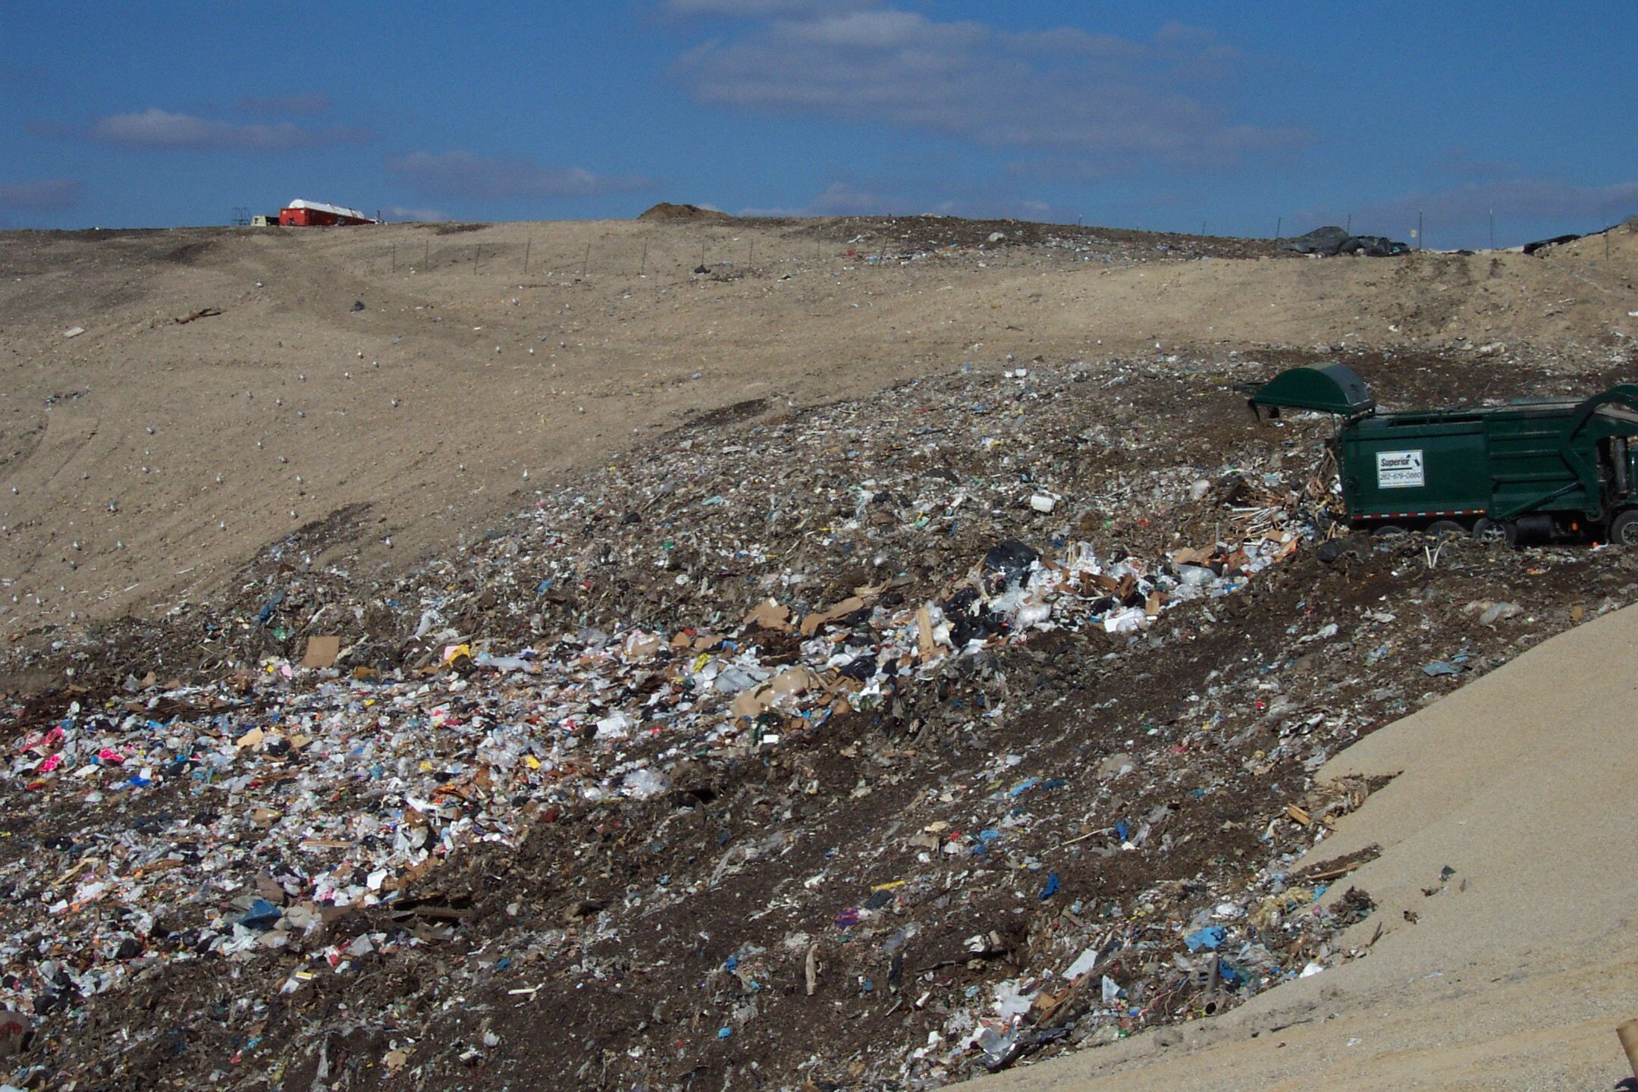
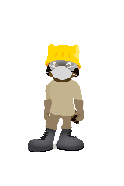
A LANDFILL is a gigantic hole where we bury our garbage!
Trash
Notes:
It gets hauled to a LANDFILL or sometimes it is called the dump.
It starts as a gigantic hole that gets filled until it becomes an enormous hill of trash!

Slide 19
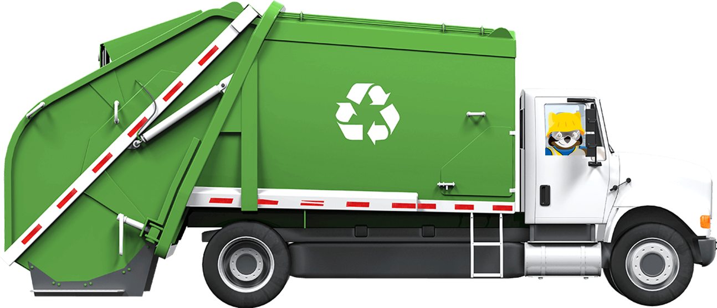
RECYCLING Collection
Recycle
Notes:
When recycling is collected, where does it go?

Slide 20



RECYCLING goes to the Materials Recovery Facility
Recycle
Notes:
The place recyclables go to is called the Materials Recovery Facility or MRF.

Slide 21







Humans and robots sort the recycling then bail it up and ship to manufactures
Recycle
Notes:
Once recyclables are loaded on a conveyor belt, they will get sorted into glass, metals, paper cardboard and plastics by equipment, humans and even robots.
Then it gets bailed-up like hay and is purchased by manufactures.
The manufacturers make new things from the recyclables, and we buy it again at the store.

Slide 22











Is that recyclable?
Recycle
Trash
Notes:
Are you ready to play a game?
Optional Activity: Is That Recyclable?? KNOW WHERE TO THROW!
Plastic bottle = Recycle Dirty napkin = Trash Metal can = Recycle Meat = Trash
Clothes + shoes = Center > donate Plastic bag = Center > bring back to grocery store Pop can = Recycle Diaper = Trash Plastic milk carton = Recycle Cheese = Trash Cardboard = Recycle Toys = Center > donate

Slide 23


Remember… Your Actions Matter

